Slide 1

Next.js 13
Your Odyssey into
Full Stack Mastery
SME: Sarthak S Kumar
Real time chat application
7-10-23
Rahul Senthil Kumar (PES2202300459)
Ram Prakhyath Annamreddy (PES2202300355)

Slide 2
Project Introduction/Abstract
In this project, we've created a chat app that works like a virtual meeting place. It lets people chat and hang out online in real-time, just like talking in person. It's simple to use, from the moment you log in to having fun conversations, and you can easily log out when you're finished. It's like a cool virtual hangout spot for chatting with friends.

Slide 3
Project Applications/Innovation
Can be used for real time communication between multiple people from different parts of the world.
Can be hosted temporarily using a temporary https link using ngrok.

Slide 4
peo
Project Features
We have included features like:
*Displaying who are online at the moment.
*A feature which requires you to enter a username before you enter the chat. This username is how you will be identified to other users.

Slide 5
Tech Stack and Tools Used
HTML/CSS - for building and designing the framework.
Javascript - for scripting on both the server and client end.
Express and Socket.io Framework - A library for enabling real-time, bidirectional communication between the server and clients over WebSocket or other transport mechanisms.
Node – for providing runtime environment for the js code.

Slide 6
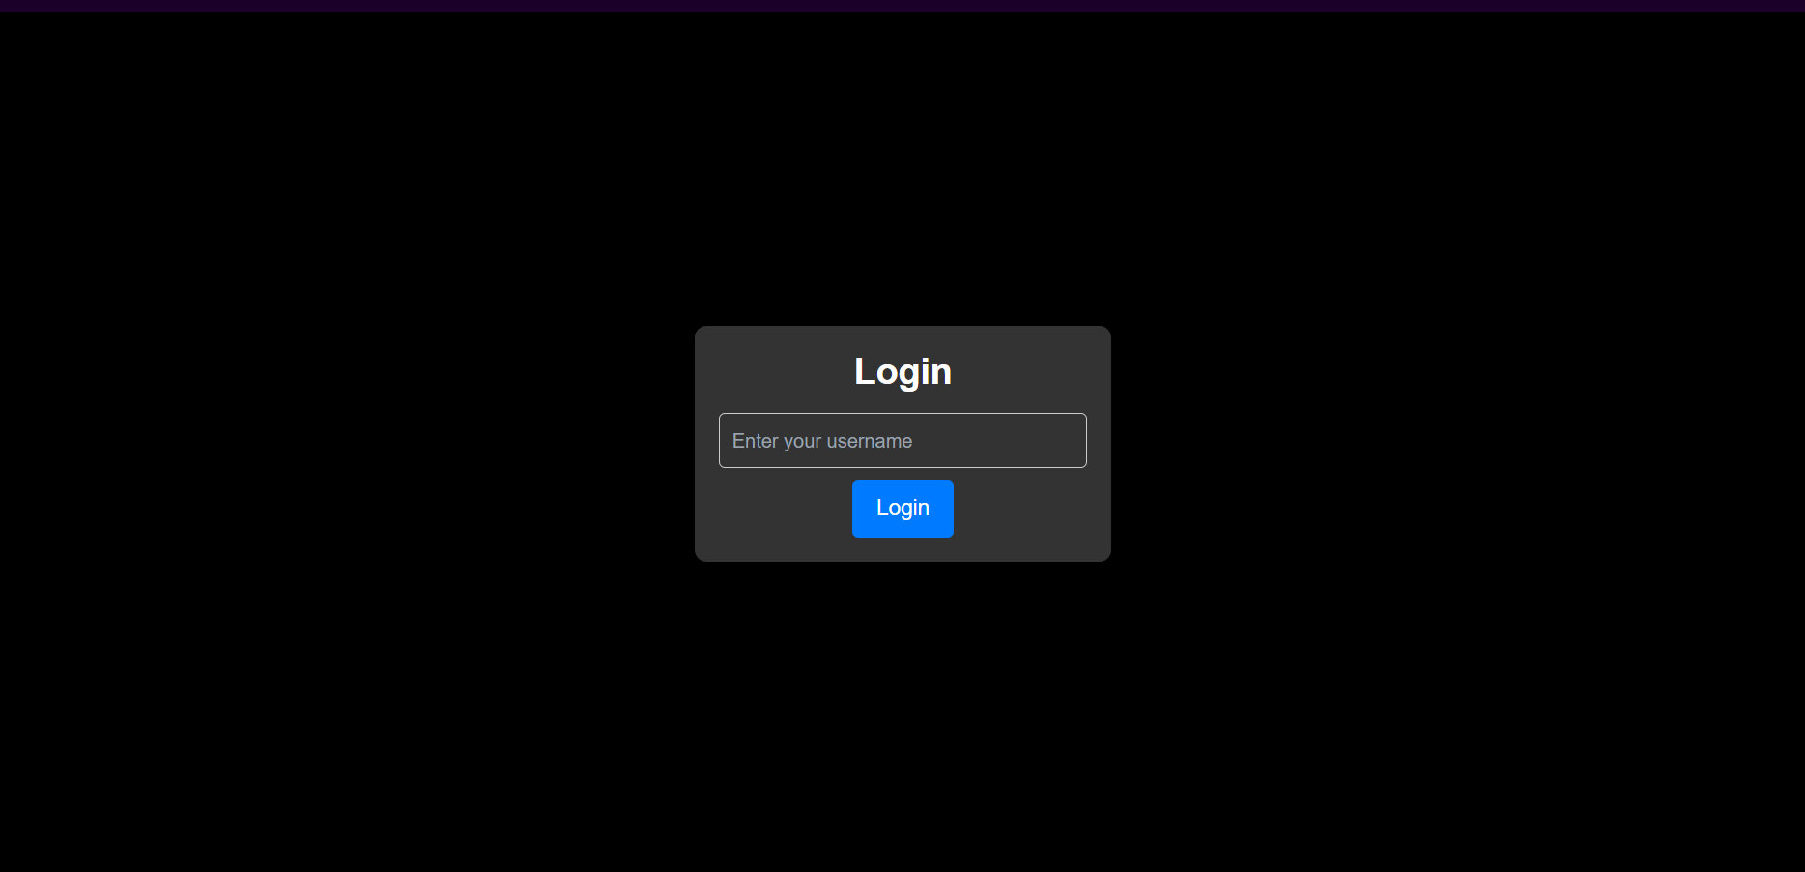
Project Screenshots
Login Page

Slide 7
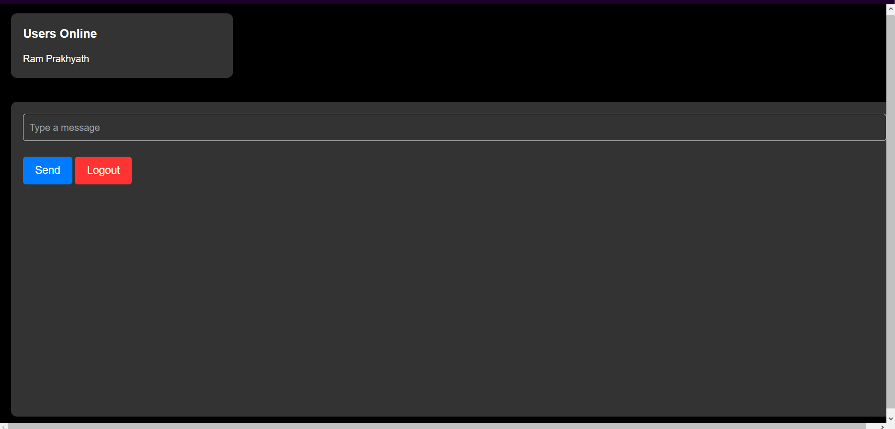
Chat Page

Slide 8
Project Structure and Effort
Project Structure
/public →
client.js index.html styles.css
package.json package-lock.json server.js
Project effort:
Design and UX
Frontend Development
Backend Development
Testing and Debugging

Slide 9
Thank You

